Slide 1
Create Agency!
Suggestions for Emerging Atypicals Dan Mailman

Slide 2
Note
This page is also available as a PDF article and a PowerPoint slideshow.

Slide 3
The Nature of Atypicality

Slide 4
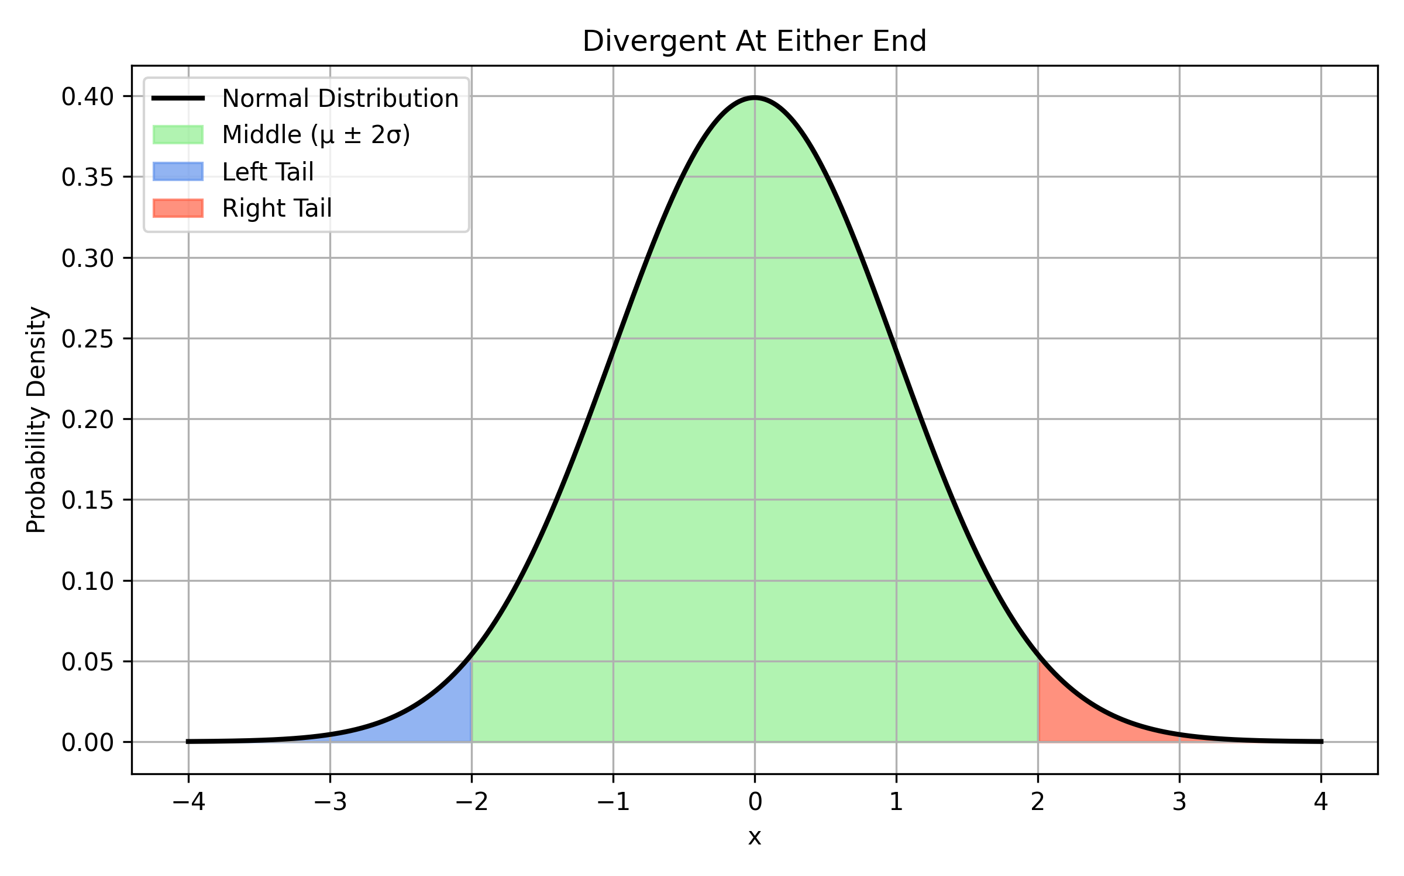
Neuro “Divergent”
Distribution: Bell Curve

Slide 5
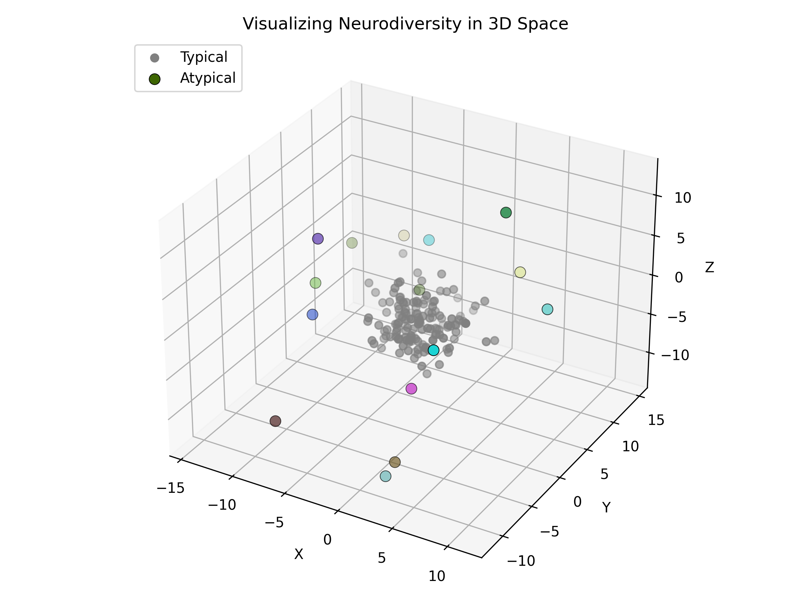
Neuro “Atypical”
Scatter: Clustered with Outliers

Slide 6
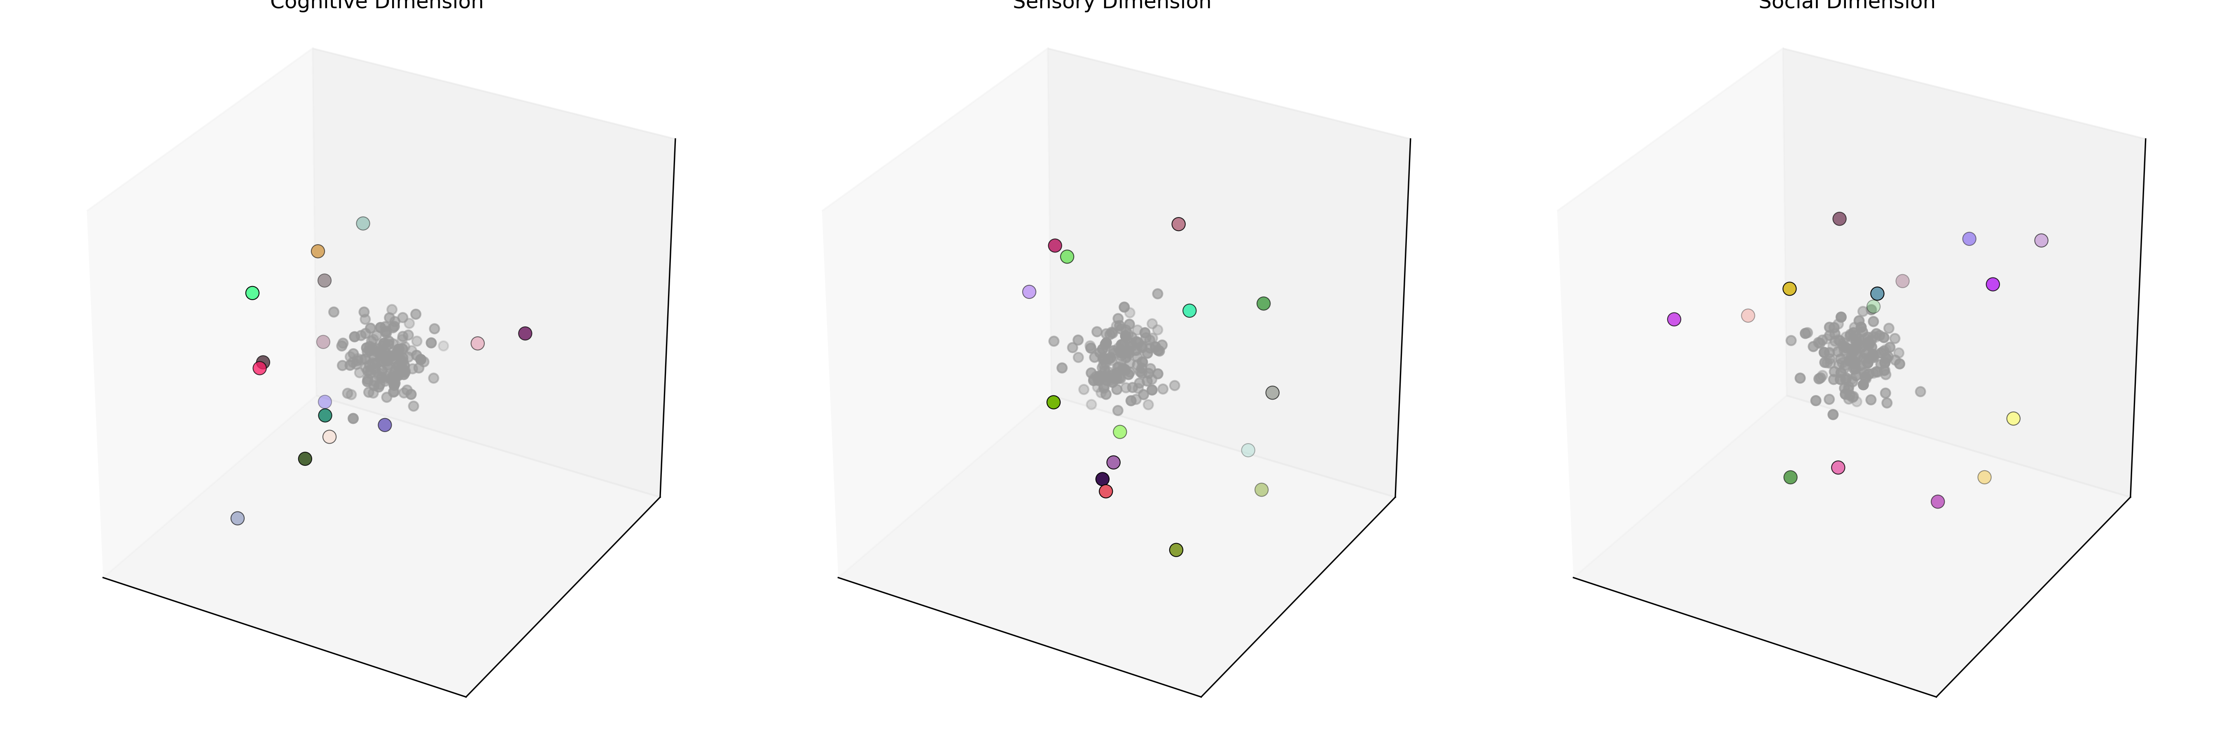
But Maybe…
Scatter: Many, Many Dimensions with Outliers

Slide 7
Agency

Slide 8
(1) We Function Best When Our Model is “All and Only”
The previous three slides represent mental models of our condition:
The 3D model helps me understand myself in relation to most people I meet. It’s about orientation—where I stand, not just how far.
The bell curve helps me understand how others tend to categorize me. It’s their frame—not mine—but it’s critical for functioning in society.
The Multi-D model reminds me how absurd it is to think any single model can capture it all. Life is richer—and messier.
*Since we are all different kinds of atypical, create your own model.
Suggestions: - Aim for accuracy over identity: Revise, revise, revise. - Consider that these are often the same: Believe, Know, Suspect, Have Faith In. - Be willing to be wrong—and change quickly. - “Don’t believe everything you think.” - I use the acronym CWH – Current Working Hypothesis – to remind myself: > It’s okay to adjust the model as the data changes.

Slide 9
The Habit of Linguistic Restructure
The original title of this talk was
Using Linguisitic Transformation to Define An Agentic Path gets us to.

Slide 10
The Secrets of the Universe

Slide 11
“Begin Anywhere”

Slide 12
If There’s a Path, Take a Step!

Slide 13
Let’s practice with a game, “Hey Sherlock!”
If you see one, yell “Opportunity”
“We are not broken.” That’s the only time I’ll say it.
Because focus takes practice. And this talk is about building, not reacting.
Audience rule: 🗣 If I slip back into talking about what we are not— Yell “BZZZ!”

Slide 14
Universal Principle #1
Tools make things easier
If a tool doesn’t reduce friction, it’s not a tool—it’s an ornament.

Slide 15
My Origin Story
First autistic diagnosis in Houston, TX
Parents: Biology professors with scientific instincts
Fairhill Elementary: early adaptive education
Learned to build systems—and learned to omit myself from them

Slide 16
Universal Principle #2
You can choose your conversations
You don’t owe your attention to every signal. You can step in. You can step out. You can rewrite your role.

Slide 17
Theory of Everything (ToE)
My ToE: - All information is culturally transmitted - Cultures are sets of conversations - Conversations are bundles of information
I use this to choose where—and how—I participate.

Slide 18
CWH: Working Hypotheses
“Believe,” “know,” “understand”—for me, they’re all shorthand for: Current Working Hypothesis
This gives me: - Flexibility without shame - Strength without arrogance - A toolbox, not a dogma

Slide 19
Universal Principle #3
Accurate models enable effective action
Example: Jobs - Companies may see NA employees as risky - Consultants = lower perceived risk - I don’t apply—I propose → And that has opened doors a résumé couldn’t

Slide 20
Final Principle (for now)
You will build your own tools. These are mine. Use them as blanks. Modify. Break. Rebuild.
The point isn’t to follow— It’s to practice agency by modeling and building in your own way.

Slide 21
Thank You
Dan Mailman dan@danmailman.net Website & PDF: [add URL]

